Slide 1
edge detection (Digital Image Processing)
Faculty of Information Technology Ton Duc Thang University
August 2023

Slide 2
Edge Detection
Extracting The Edges From An Image
Objective
What is edge detection and how it can be helpful in image classification.
Learn how kernels are used to identify the edges in a given image.
https://www.analyticsvidhya.com/blog/2021/03/edge-detection-extracting-the-edges-from-an-image/

Slide 3
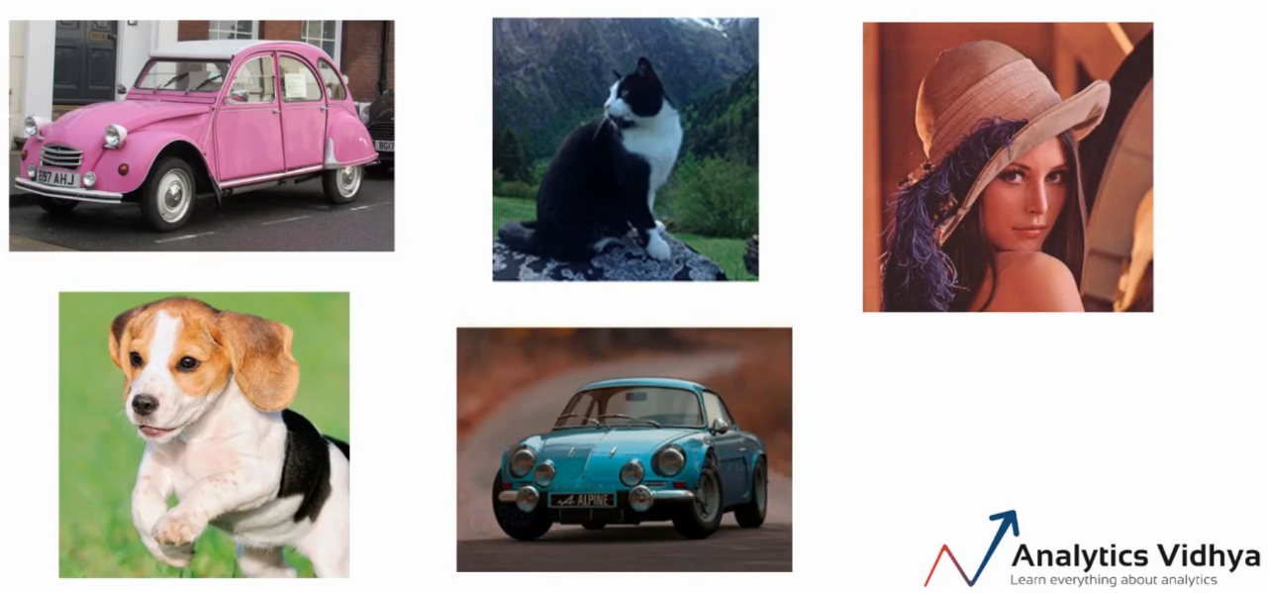
Edge Detection: image classification
Can you differentiate between the objects?

Slide 4
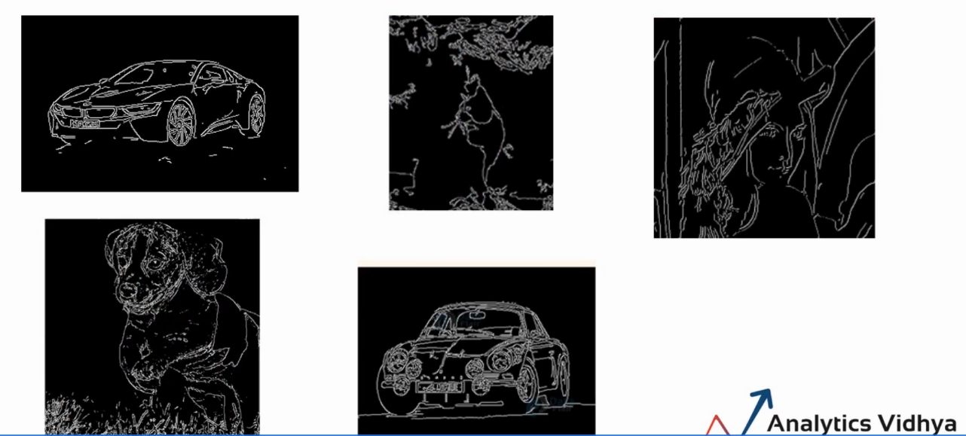
Edge Detection: image classification
Can you still easily classify the images?

Slide 5
Edge Detection: image classification
removed the color, the background, and the other minute details from the pictures
extract only the edges, we would still be able to classify the image.

Slide 6
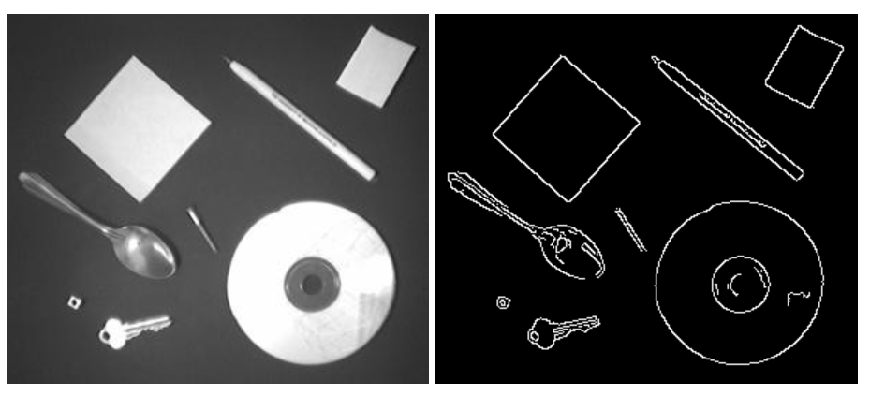
Edges
Edges are significant local changes of intensity in an image.
Edges typically occur on the boundary between two different regions in an image (Trucco, Chapt 4 AND Jain et al., Chapt 5)

Slide 7
Goal of edge detection
Produce a line drawing of a scene from an image of that scene
Important features can be extracted from the edges of an image (e.g., corners, lines, curves)
These features are used by higher-level computer vision algorithms (e.g., recognition)

Slide 8
What causes intensity changes?
Geometric events
object boundary (discontinuity in depth and/or surface color and texture)
surface boundary (discontinuity in surface orientation and/or surface color and texture)
Non-geometric events
specularity (direct reflection of light, such as a mirror)
shadows (from other objects or from the same object)
inter-reflections

Slide 9

Edge Detection
Identify the edges by looking at the numbers or the pixel values
there is a significant difference between the pixel values around the edge

Slide 10
Edge Detection (ct)
Edge detection is an image processing technique for finding the boundaries of an object in the given image
Edges are the part of the image that represents the boundary or the shape of the object in the image
the pixel values around the edge show a significant difference or a sudden change in the pixel values
Based on this fact we can identify which pixels represent the edge or which pixel lie on the edge.

Slide 11
How to Extract the Edges
compare the pixel values with its surrounding pixels, to find out if a particular pixel lies on the edge
use a matrix known as the kernel and perform the element-wise multiplication

Slide 12
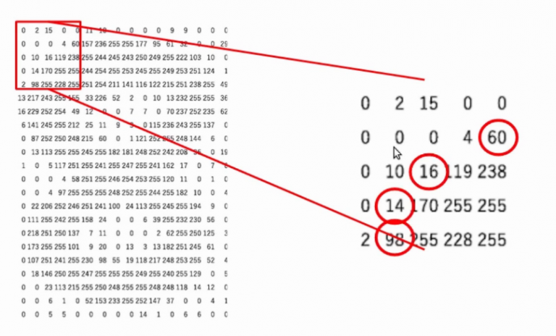
How to Extract the Edges (ct)

Slide 13
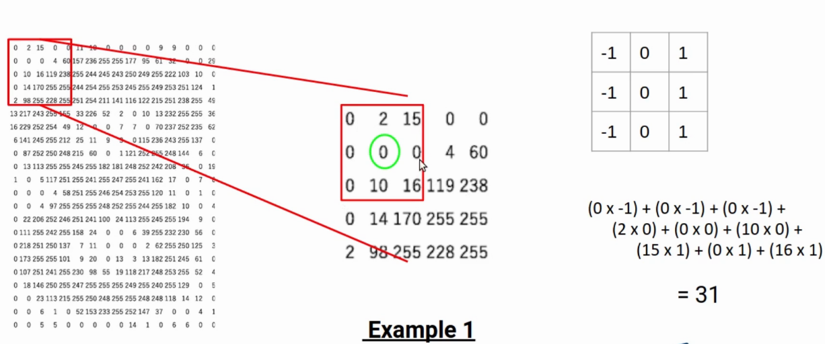
How to Extract the Edges (ct)

Slide 14
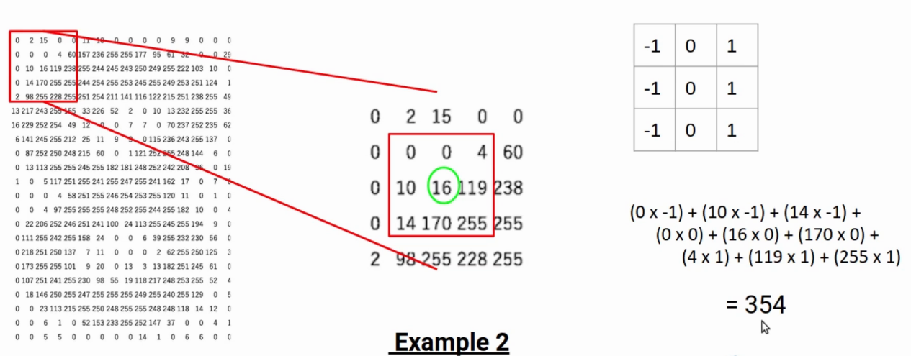
How to Extract the Edges (ct)

Slide 15
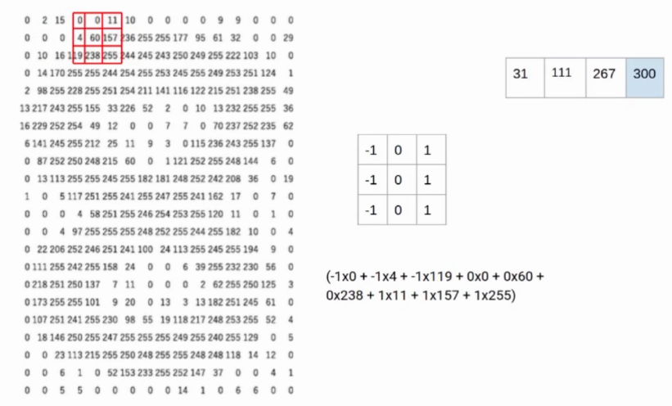
How to Extract the Edges (ct)

Slide 16
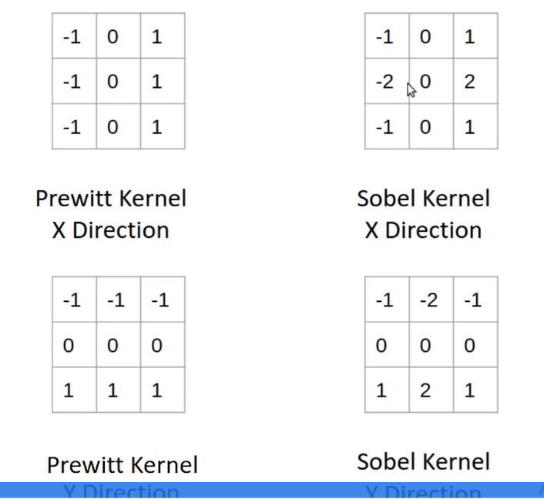
Prewitt & Sobel kernels
Sobel kernels, higher importance is given to the pixel values right next to the target pixel

Slide 17
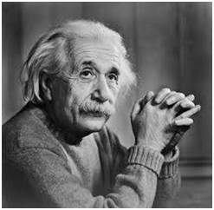
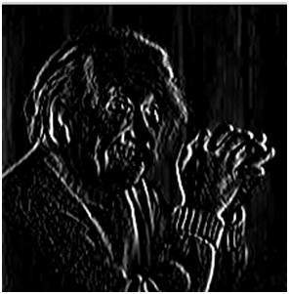
Prewitt kernels
-1 | 0 | 1
-1 | 0 | 1
-1 | 0 | 1
Vertical direction

Slide 18
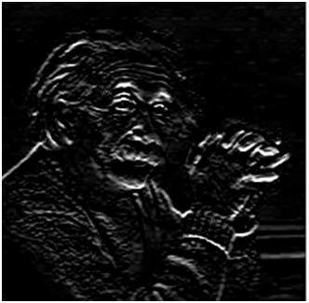
Prewitt kernels (ct)
-1 | -1 | -1
0 | 0 | 0
1 | 1 | 1
Horizontal direction

Slide 19
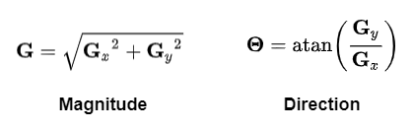
Prewitt kernel – both directions

Slide 20
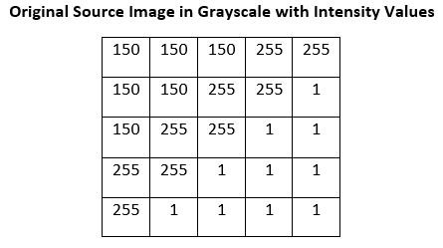
Ex. 1
Apply Prewitt/Sobel operators in X direction, Y direction, and both directions into the following image:

Slide 21

Edges again
An edge is a place of rapid change in the image intensity function
Points which lie on an edge can be detected by
detecting local maxima or minima of the first derivative
edges correspond to extrema of derivative

Slide 22
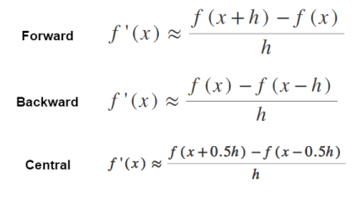
Edges and derivate
derivatives only exists for continuous functions but the image is a discrete 2D intensity function
approximated the image gradients using finite approximation as
https://theailearner.com/tag/prewitt-operator/
prefer the central difference as shown above

Slide 23
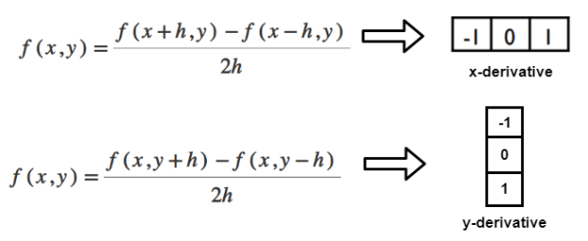
Edges and derivate (ct)
obtain the derivative filter in x and y directions as shown below
assumed that the x-coordinate is increasing in the “right”-direction, and y-coordinate in the “down”-direction
By weighting these x and y derivatives, we can obtain different edge detection filters

Slide 24
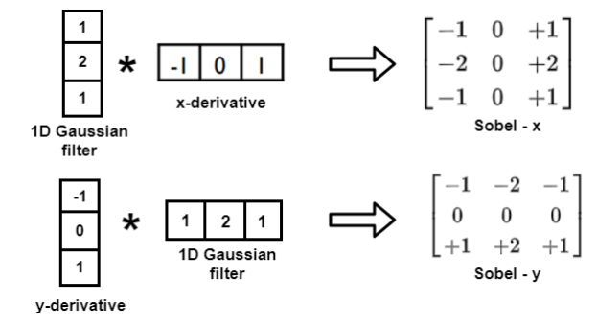
Sobel Operator
multiplying the x, and y-derivative filters obtained above with some smoothing filter(1D) in the other direction
For example, a 3×3 Sobel-x and Sobel-y filter can be obtained as
Gaussian filter is used for blurring thus, the Sobel operator computes the gradient with smoothing

Slide 25
Sobel operators (ct)
Convolve these Sobel operators with the image, they estimate the gradients in the x, and y-directions(say Gx and Gy). For each point, we can calculate the gradient magnitude and direction as
https://docs.opencv.org/3.4/d2/d2c/tutorial_sobel_derivatives.html

Slide 26
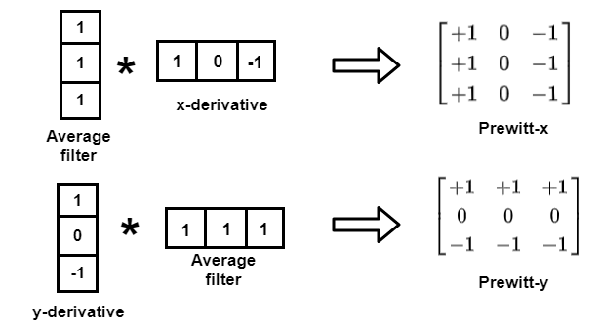
Prewitt Operator
x, and y-derivative filters are weighted with the standard averaging filter as shown below

Slide 27
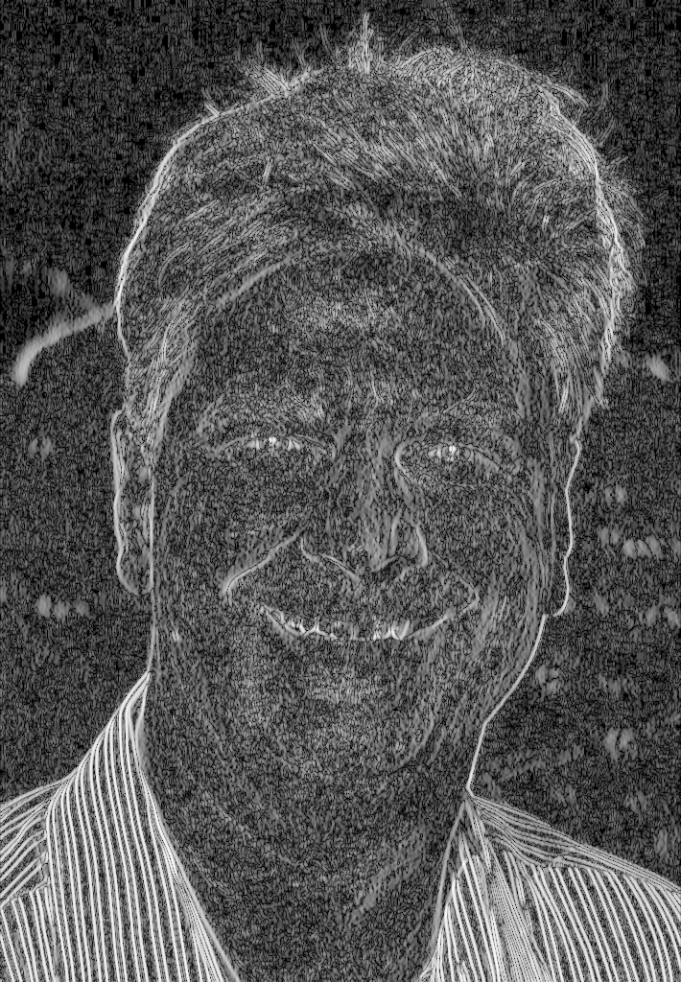

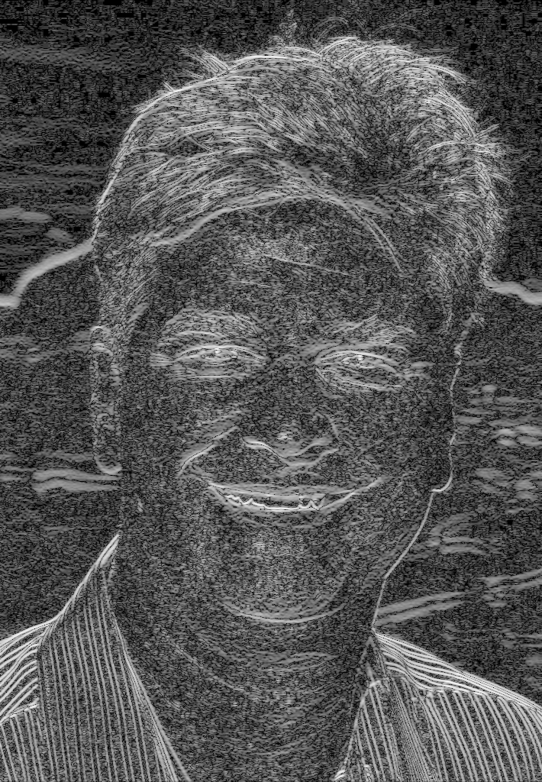
Prewitt operator example
⎛⎛
⎮
⎮
⎮⎛
−1 0
−1 [0]
−1 0
₁ ⎞
₁ ⎮
⎮
₁ ⎮⎠
Original
1024x710
⎛⎛
⎮
⎮
⎮⎛
−1 −1 −1 ⎞
0 [0] 0 ⎮
1 1 1
⎮
⎮⎠
Digital Image Processing: Bernd Girod, © 2013 Stanford University -- Edge Detection 27

Slide 28
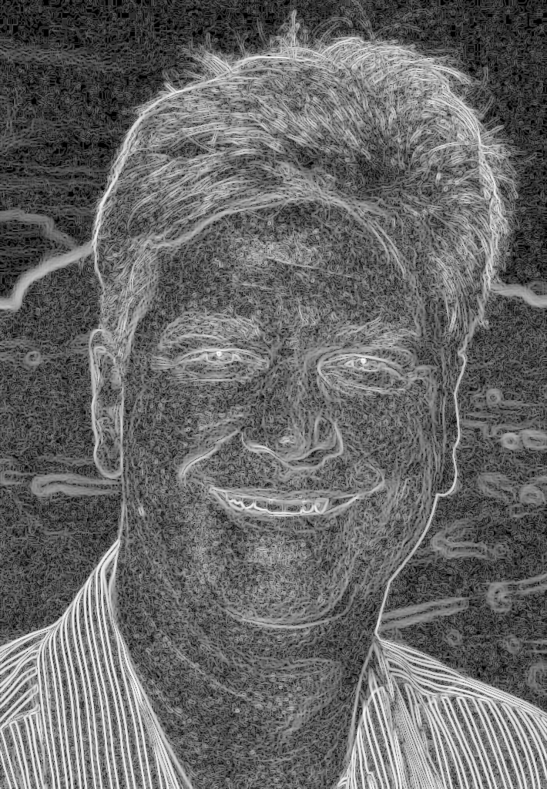
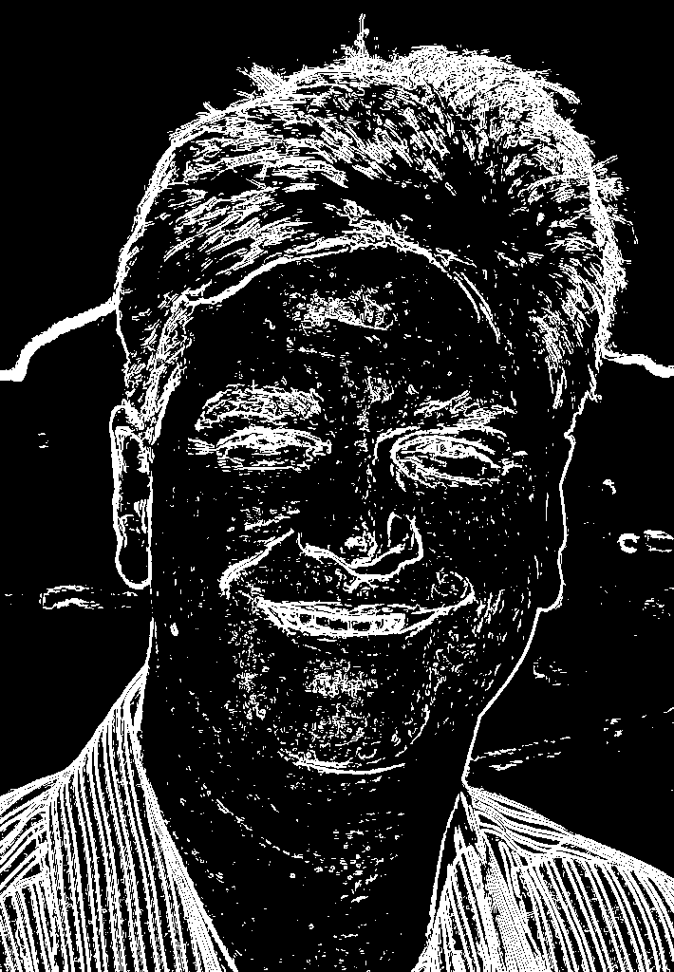
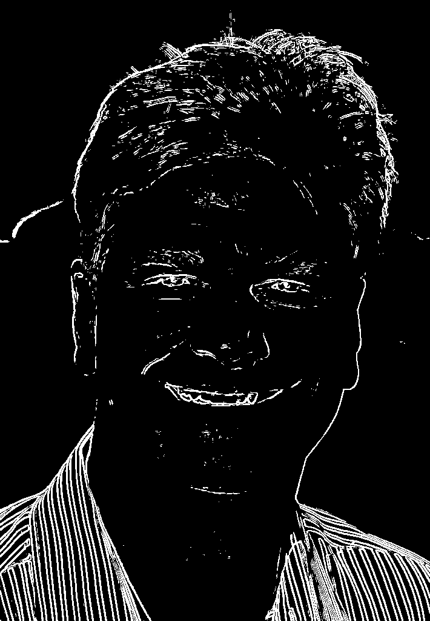
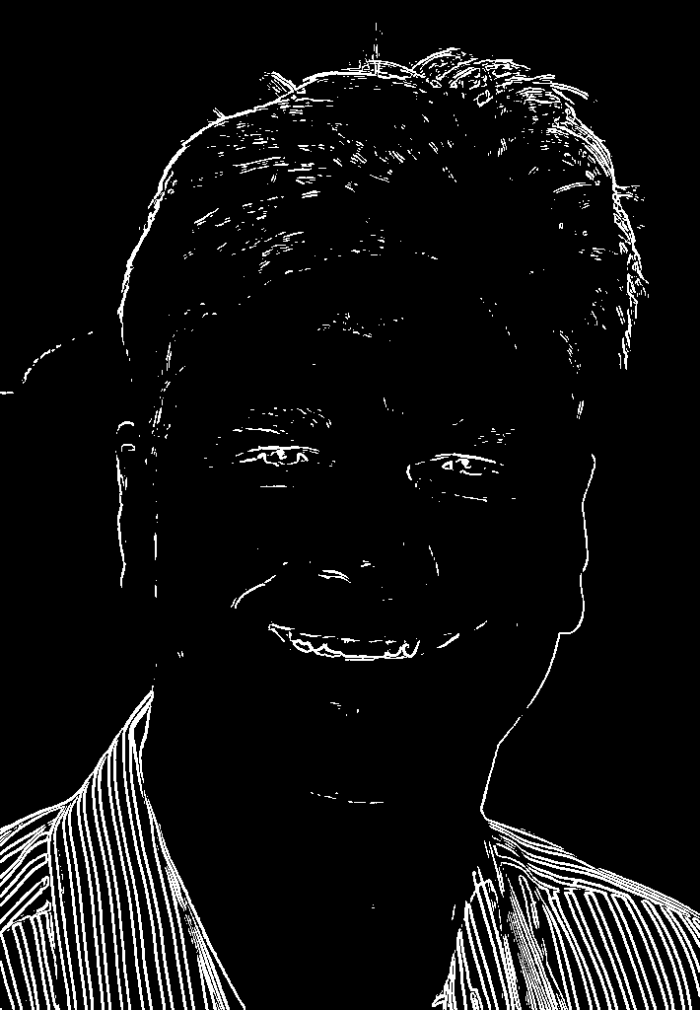
Prewitt operator example (cont.)
Sum of squared horizontal and vertical gradients (log display)
threshold = 900
threshold = 4500
threshold = 7200
Digital Image Processing: Bernd Girod, © 2013 Stanford University -- Edge Detection 28

Slide 29
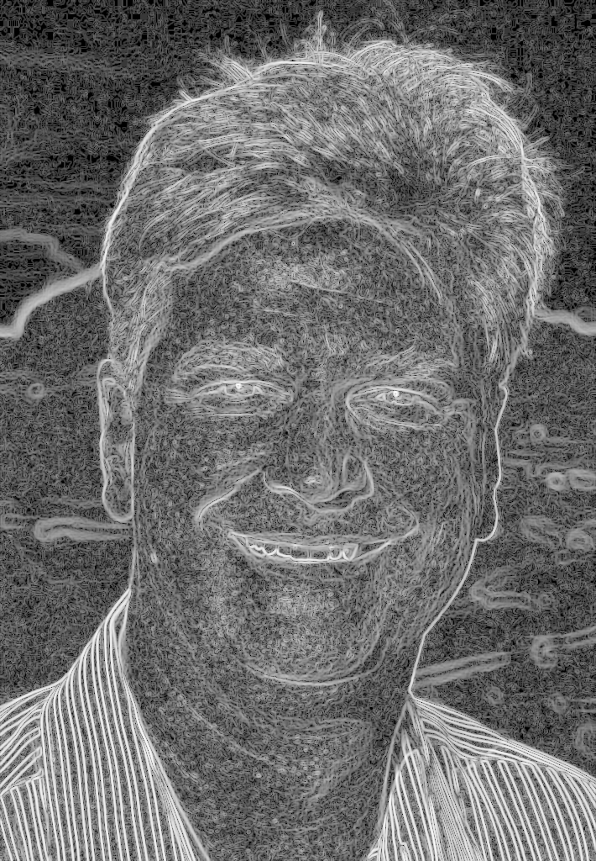


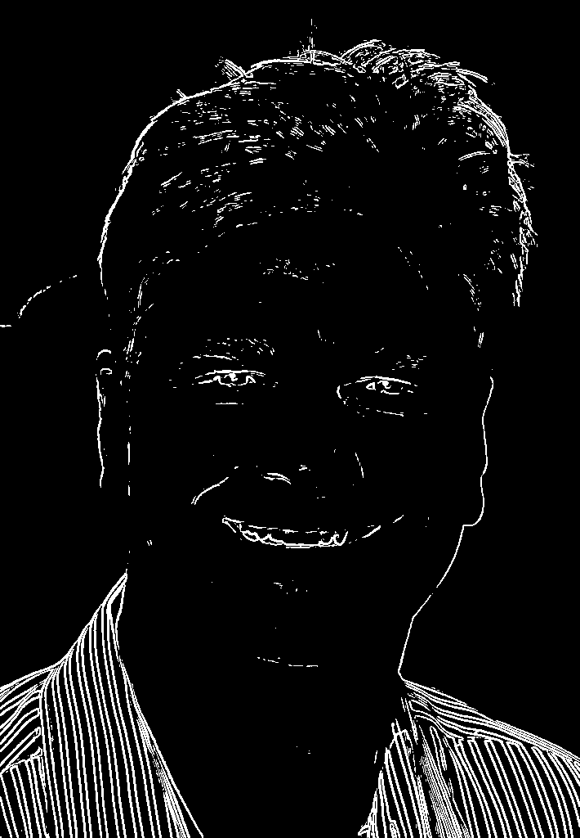
Sobel operator example
Sum of squared horizontal and vertical gradients (log display)
threshold = 1600
threshold = 8000
threshold = 12800

Slide 30
Canny Edge Detection
Canny Edge Detection is a popular edge detection algorithm. It was developed by John F. Canny
It is a multi-stage algorithm:
Noise Reduction
Edge detection is susceptible to noise in the image, first step is to remove the noise in the image with a Gaussian filter
https://docs.opencv.org/4.x/da/d22/tutorial_py_canny.html

Slide 31
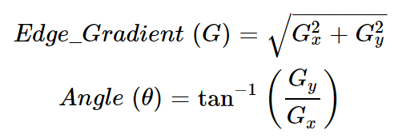
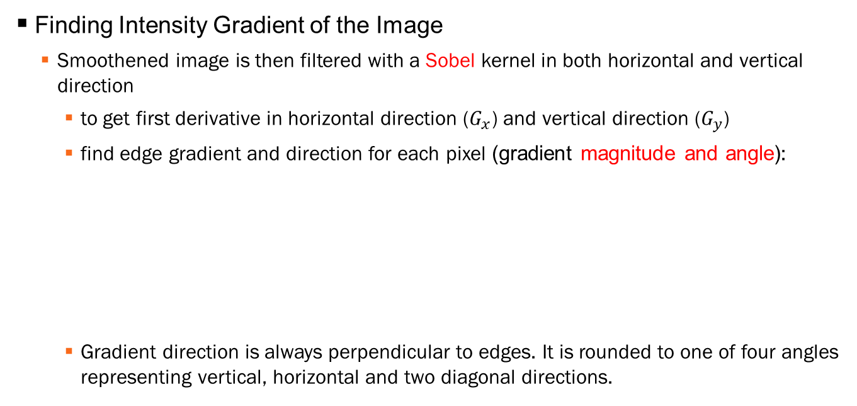
Canny Edge Detection (ct)
Finding Intensity Gradient of the Image
Smoothened image is then filtered with a Sobel kernel in both horizontal and vertical direction
to get first derivative in horizontal direction ($G_{x}$) and vertical direction ($G_{y}$)
find edge gradient and direction for each pixel (gradient magnitude and angle):
Gradient direction is always perpendicular to edges. It is rounded to one of four angles representing vertical, horizontal and two diagonal directions.

Slide 32
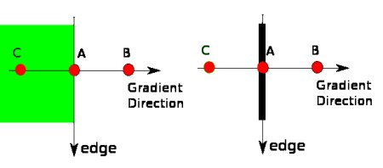
Canny Edge Detection (ct)
Non-maximum Suppression
remove any unwanted pixels which may not constitute the edge
at every pixel, pixel is checked if it is a local maximum in its neighborhood in the direction of gradient
Its gradient magnitude is smaller than either of its neighbors?
Point A is on the edge ( in vertical direction). Point B and C are in gradient directions. So point A is checked with point B and C to see if it forms a local maximum. If so, it is considered for next stage, otherwise, it is suppressed ( put to zero).

Slide 33
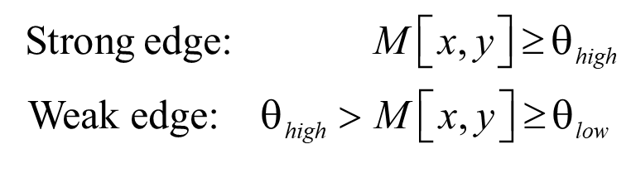
Canny Edge Detection (ct)
Hysteresis Thresholding
This stage decides which are all edges are really edges and which are not
Use two threshold values, minVal and maxVal
Any edges with intensity gradient more than maxVal are sure to be edges and those below minVal are sure to be non-edges
Those who lie between these two thresholds are classified edges or non-edges based on their connectivity. If they are connected to "sure-edge«(strong edge) pixels, they are considered to be part of edges. Otherwise, they are also discarded.

Slide 34
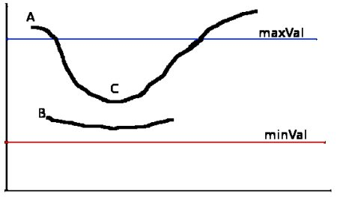
Canny Edge Detection (ct)
The edge A is above the maxVal, so considered as "sure-edge". Although edge C is below maxVal, it is connected to edge A, so that also considered as valid edge and we get that full curve. But edge B, although it is above minVal and is in same region as that of edge C, it is not connected to any "sure-edge", so that is discarded.

Slide 35
Canny Edge Detection (ct)
Hysteresis Thresholding
This stage also removes small pixels noises on the assumption that edges are long lines
https://docs.opencv.org/4.x/da/d22/tutorial_py_canny.html

Slide 36
Ex. 2
Apply Canny operator into the following image:

Slide 37
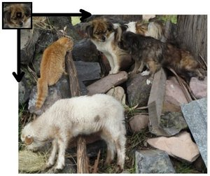
Template Matching
a technique for finding areas of an image that match (are similar) to a template image (patch)
compare the template image against the source image by sliding it
https://docs.opencv.org/3.4/de/da9/tutorial_template_matching.html

Slide 38
Template Matching (ct)
moving the patch one pixel at a time (left to right, up to down)
At each location, a metric is calculated so it represents how "good" or "bad" the match at that location is (or how similar the patch is to that particular area of the source image)
https://docs.opencv.org/3.4/d4/dc6/tutorial_py_template_matching.html

Slide 39
OpenCV & Machine Learning
Machine Learning Library (MLL) is a set of classes and functions for statistical classification, regression, and clustering of data
https://docs.opencv.org/4.x/dd/ded/group__ml.html
https://docs.opencv.org/4.x/d8/d4b/tutorial_py_knn_opencv.html

Slide 40
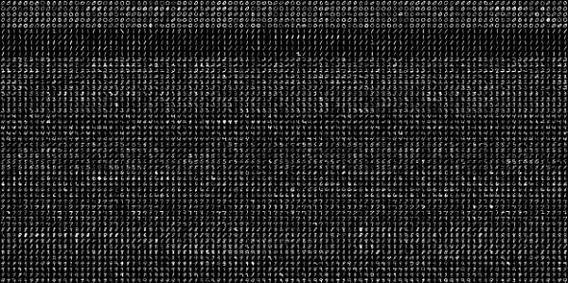
OpenCV & Machine Learning (ct)
OCR of Hand-written Data using kNN

Slide 41
References
https://docs.opencv.org/4.x/d4/d86/group__imgproc__filter.html
https://www.youtube.com/watch?app=desktop&v=kGHz-cEyjiE
https://docs.opencv.org/4.x/d4/dc6/tutorial_py_template_matching.html
https://www.youtube.com/watch?app=desktop&v=kGHz-cEyjiE
https://vincmazet.github.io/bip/filtering/convolution.html

